Slide 1

Proof (Part II)
Master Method
Design and Analysis of Algorithms I

Slide 2

The Story So Far/Case 1
Total work: $≤cn^{d }× \sum_{j=0}^{\log_{b}{n}}{{(\frac{a}{b^{d}})}^{j}}$ (*)

Slide 3
Basic Sums Fact

Slide 4
Case 2
Total work: $≤cn^{d }× \sum_{j=0}^{\log_{b}{n}}{{(\frac{a}{b^{d}})}^{j}}$ (*)

Slide 5
Case 3
Total work: $≤cn^{d }× \sum_{j=0}^{\log_{b}{n}}{{(\frac{a}{b^{d}})}^{j}}$ (*)

Slide 6
Which of the following quantities is equal to $a^{\log_{b}{n}}$?
The number of levels of the recursion tree.
The number of nodes of the recursion tree.
The number of edges of the recursion tree.
$$\text{The} \text{number} \text{of} \text{leaves} \text{of} \text{the} \text{recursion} \text{tree}\text{.}$$

Slide 7
Case 3 continued
Total work: $≤cn^{d }× \sum_{j=0}^{\log_{b}{n}}{{(\frac{a}{b^{d}})}^{j}}$ (*)

Slide 8
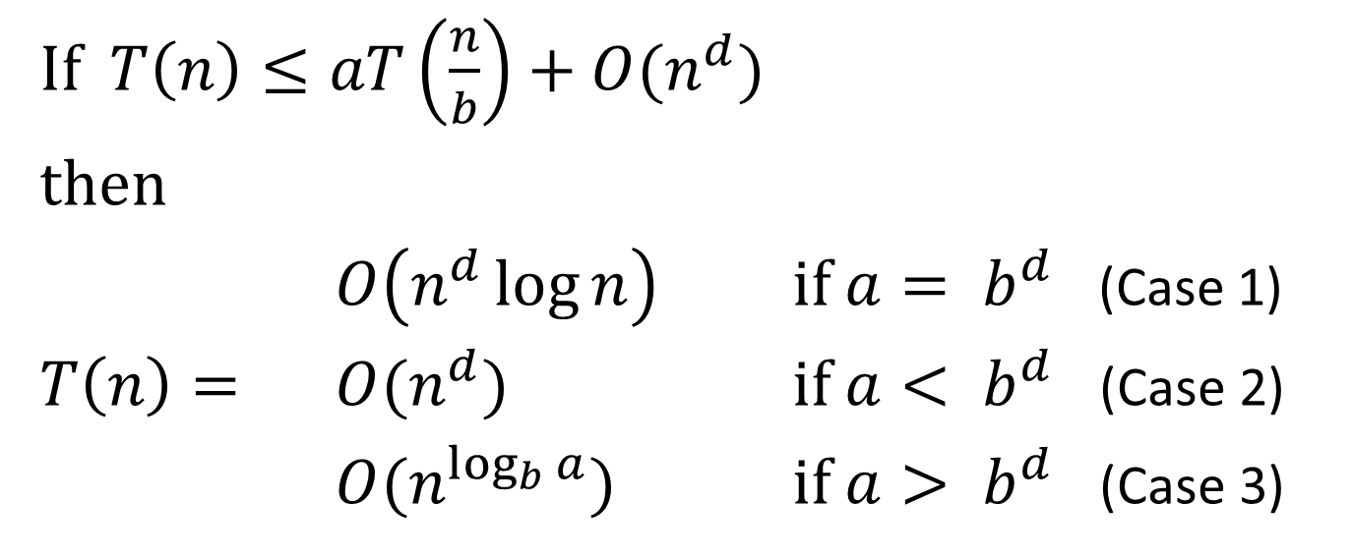
The Master Method
If $T\left(n\right)≤aT\left(\frac{n}{b}\right)+O(n^{d})$
then
$O\left(n^{d}\log{n}\right)$ if $a= b^{d}$ (Case 1)
$T\left(n\right)=$ $O(n^{d})$ if $a< b^{d}$ (Case 2)
$O(n^{\log_{b}{a}})$ if $a> b^{d}$ (Case 3)

